Slide 1
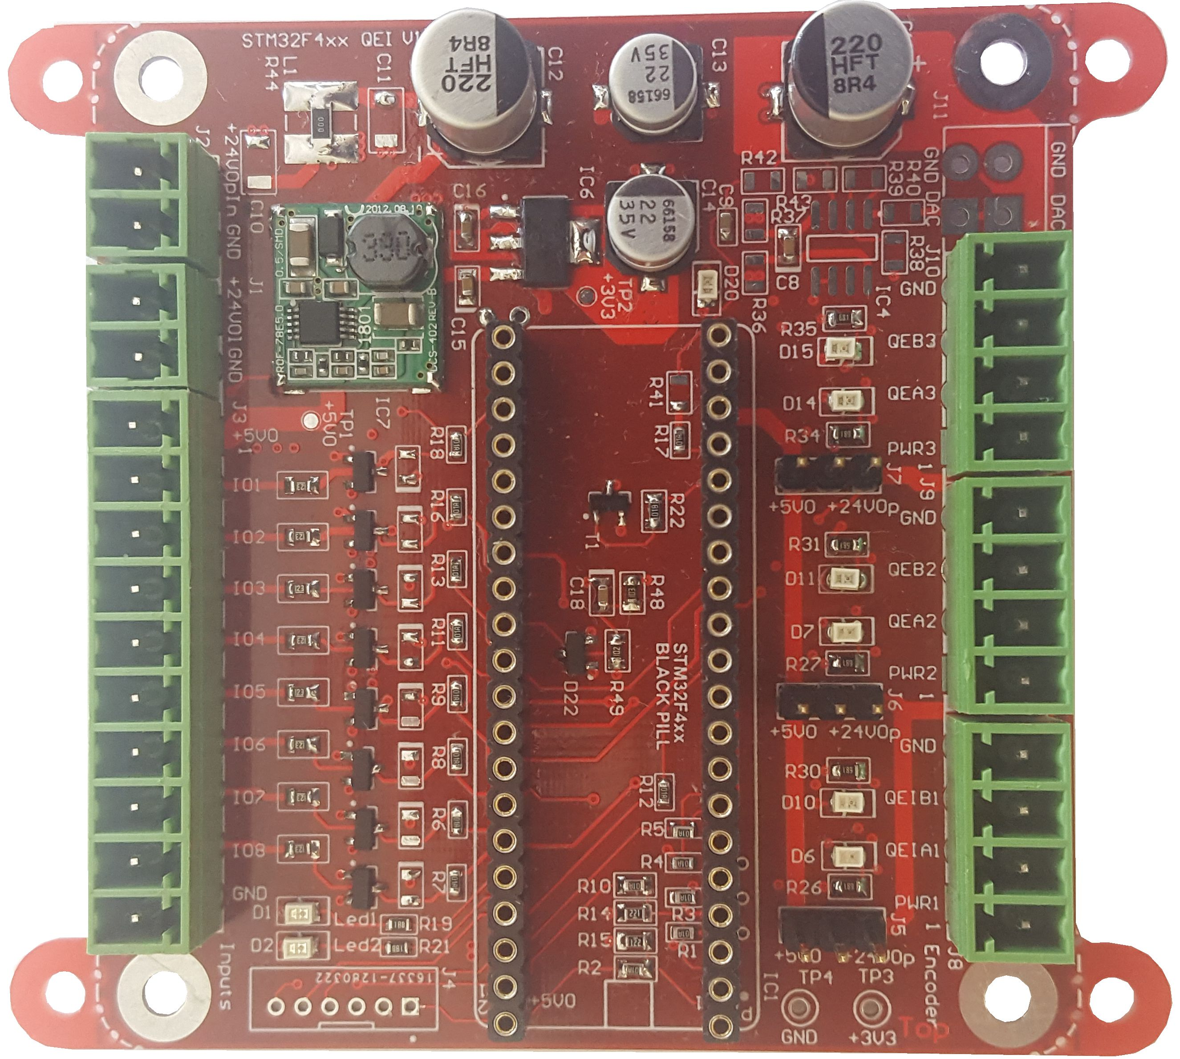
DCDC 24V to 5V
Power supply IO
1 analog resp. PWM out
Power supply controller
Encoder supply voltage selection
General purpose IOs depending on assembling
3 Encoder inputs
2,54 mm connectors
Input protection
(optional)
2 general purpose LEDs
Socket for
STM32F411 BLACKPILL-Board
Serial interface
plus 1 digital in and 1 output

Slide 2
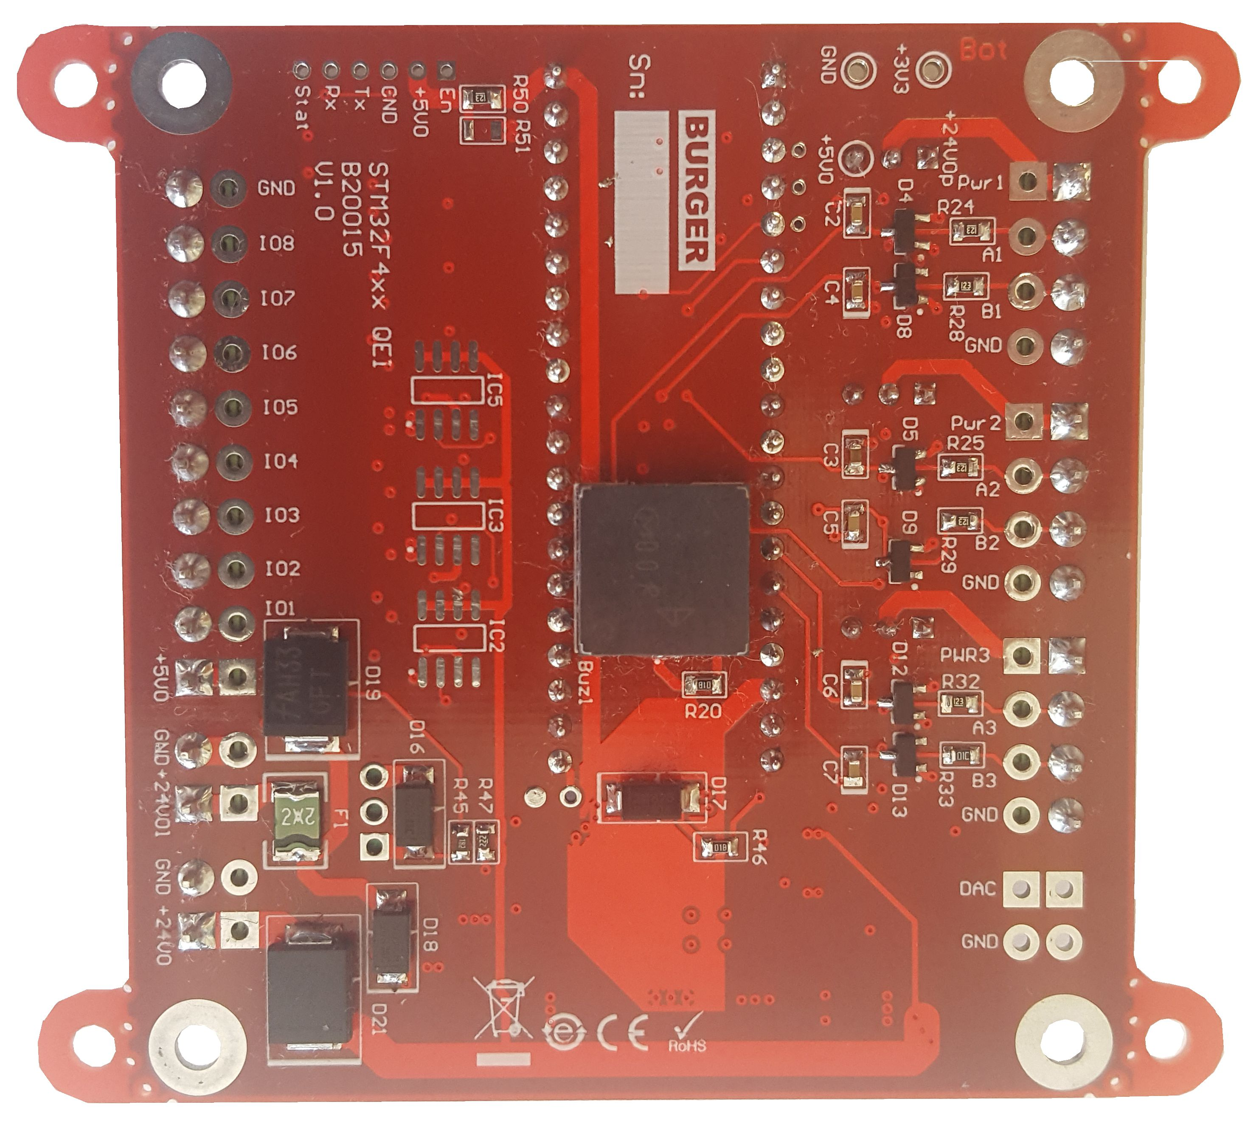
1 analog resp. PWM out
Input protection
3 PROFET outputs (optional)
Buzzer

Slide 3
W
L

